Slide 1

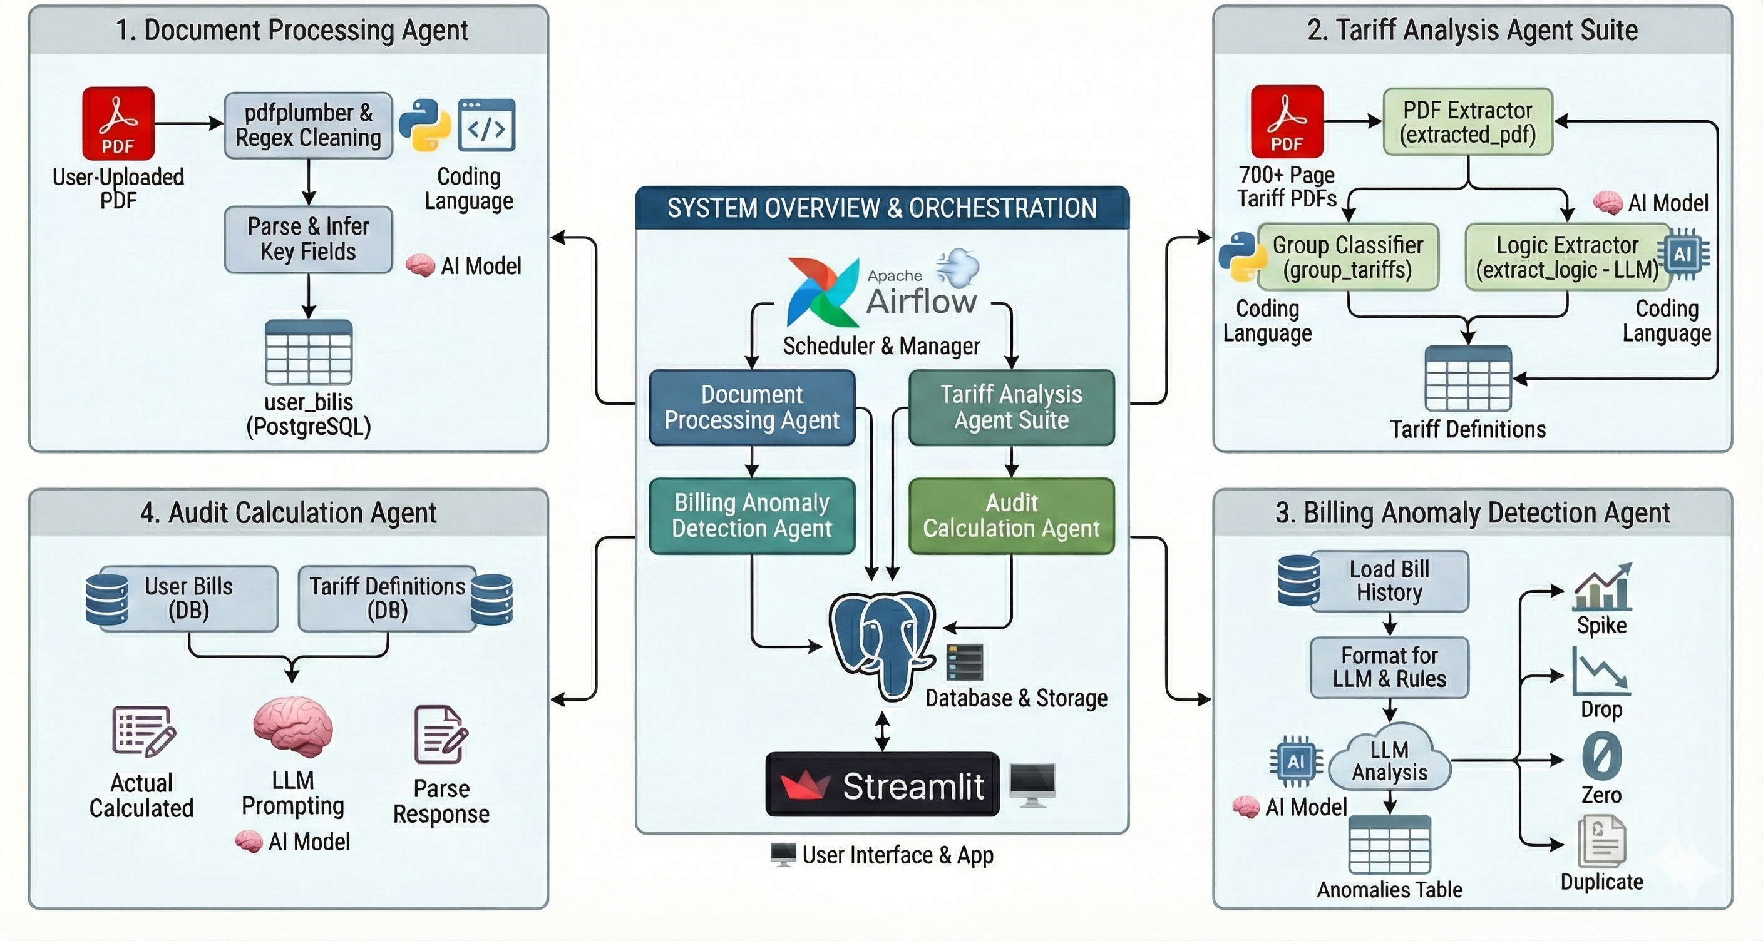
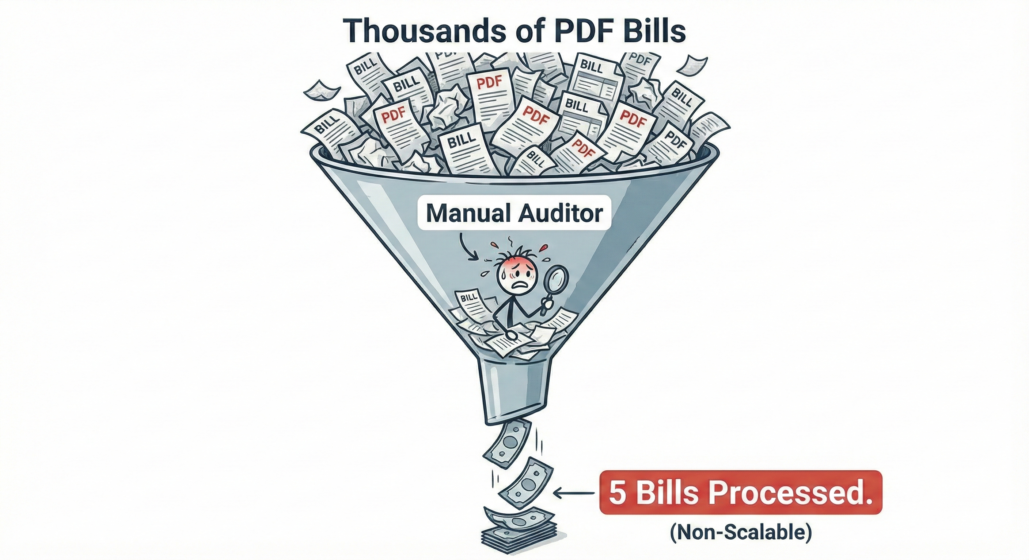
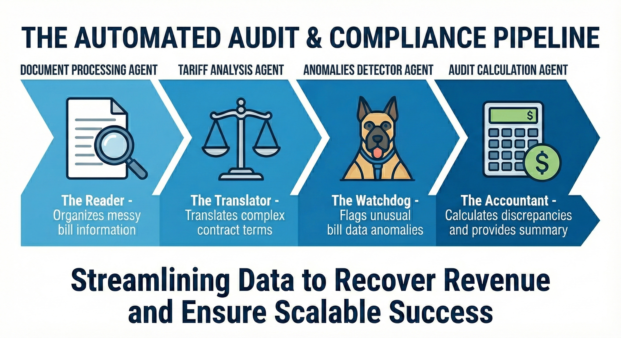
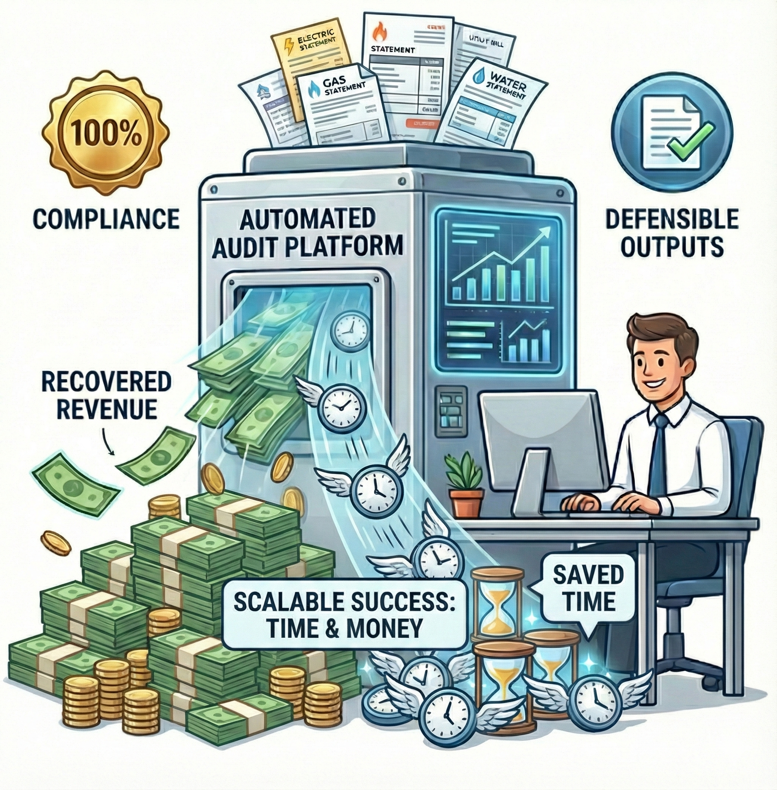
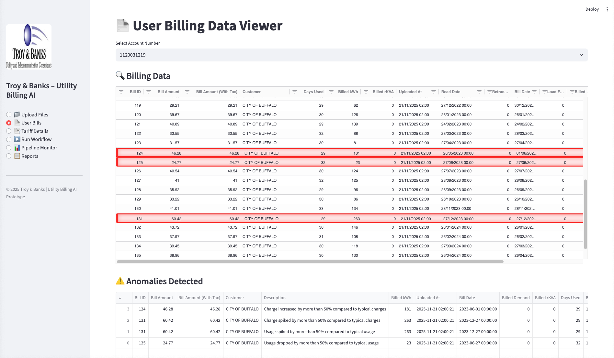
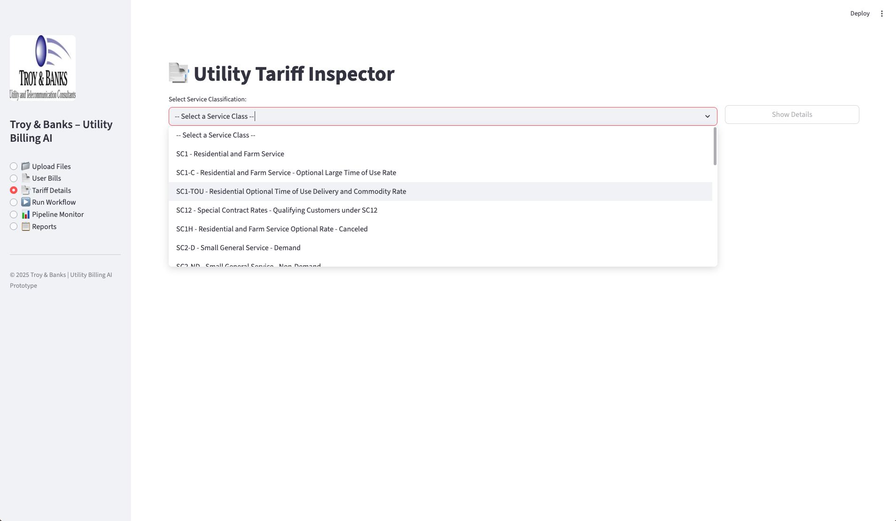
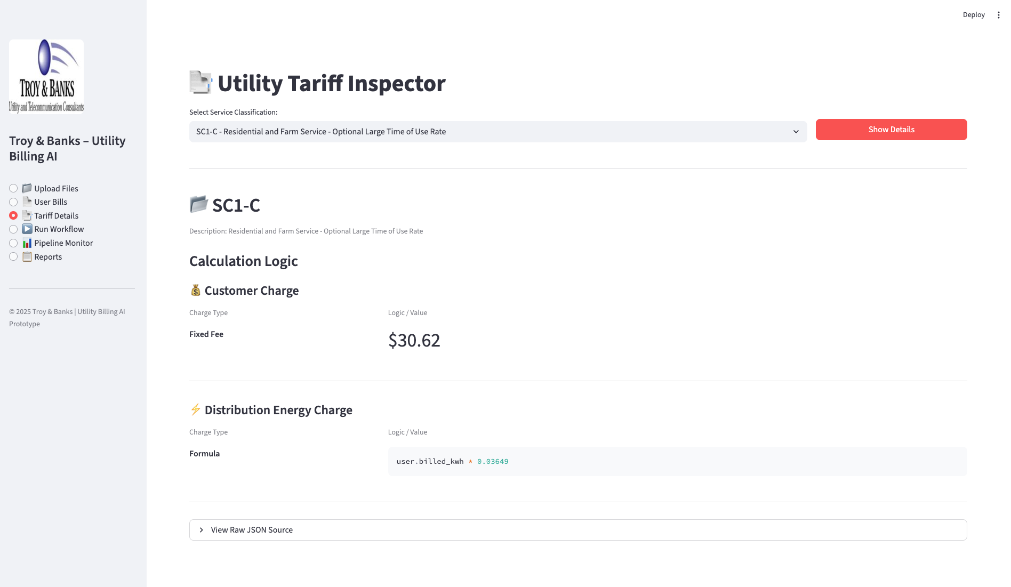
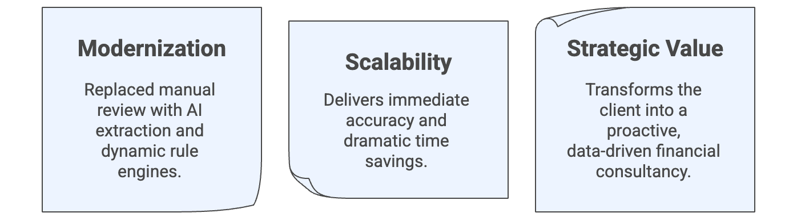






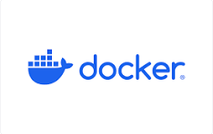

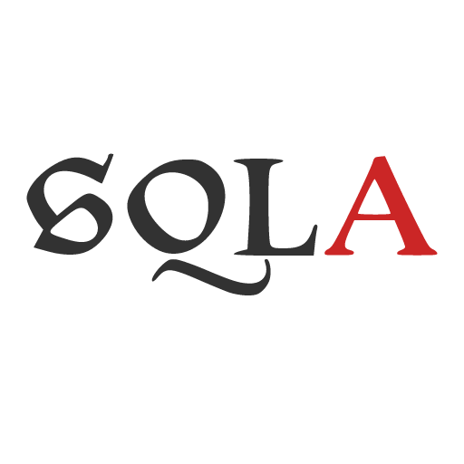



AI-Driven Utility Billing Automation:
Scalable Auditing with Dynamic Tariff Engines
Transforming Manual Energy Auditing with Multi-Agent Systems and LLMs
Team : EagleEye
Harshal Patil, Avipsa Bhujabal, Aarushi Jugran
Acknowledgements:
Kevin Gibbs, Vice President of Strategic Partnerships; Troy & Banks, Inc.
Justin Raybeck, Energy Auditor/Advisor ; Troy & Banks, Inc.
THE CHALLENGE :
SYSTEM ARCHITECTURE:
Utility auditing is a highly specialized, labor-intensive process that resists traditional automation due to data complexity.
Unscalable Workflow: Human experts require 2-4 hours to process a single complex municipal bill.
Capacity Cap: Operational limits restrict output to just 5-10 bills per day per auditor.
Data Heterogeneity:
Bills: Thousands of formats across different utility providers and service classes.
Tariffs: Pricing rules are buried in 700+ page PDF legal documents, making simple "regex" extraction impossible.
The Manual Bottleneck :
Our Agentic Pipeline:
Scalable Business Value :
DASHBOARD :
Smart Billing Audit & Visualization
Universal Tariff Explorer
Instant Tariff Logic
Impact Summary:
Voice of Our Client:
Troy & Banks is thrilled to have partnered with the amazing graduate students of the UB Graduate Program...!
This project will reduce the result time tremendously, allowing our clients to receive cost savings sooner.
Troy & Banks considers our UB team of data scientists' part of the T&B family.
— Kevin Gibbs ,
VP of Strategic Partnerships, Troy & Banks
TECH STACK :
. . . . .
Institute for Artificial Intelligence and Data Science
School of Engineering and Applied Science
Mentors: :
Prof. Adithya Narayanan,
Prof. Saverio Marrazzo

Slide 2

AI-Driven Utility Billing Automation:
Scalable Auditing with Dynamic Tariff Engines
Transforming Manual Energy Auditing with Multi-Agent Systems and LLMs
Team : EagleEye
Harshal Patil, Avipsa Bhujabal, Aarushi Jugran
Acknowledgements:
Kevin Gibbs, Vice President of Strategic Partnerships; Troy & Banks, Inc.
Justin Raybeck, Energy Auditor/Advisor ; Troy & Banks, Inc.
THE CHALLENGE :
SYSTEM ARCHITECTURE:
Utility auditing is a highly specialized, labor-intensive process that resists traditional automation due to data complexity.
Unscalable Workflow: Human experts require 2-4 hours to process a single complex municipal bill.
Capacity Cap: Operational limits restrict output to just 5-10 bills per day per auditor.
Data Heterogeneity:
Bills: Thousands of formats across different utility providers and service classes.
Tariffs: Pricing rules are buried in 700+ page PDF legal documents, making simple "regex" extraction impossible.
The Manual Bottleneck :
Our Agentic Pipeline:
Scalable Business Value :
DASHBOARD :
Smart Billing Audit & Visualization
Universal Tariff Explorer
Instant Tariff Logic
Impact Summary:
Voice of Our Client:
Troy & Banks is thrilled to have partnered with the amazing graduate students of the UB Graduate Program...!
This project will reduce the result time tremendously, allowing our clients to receive cost savings sooner.
Troy & Banks considers our UB team of data scientists' part of the T&B family.
— Kevin Gibbs ,
VP of Strategic Partnerships, Troy & Banks
TECH STACK :
. . . . .
Institute for Artificial Intelligence and Data Science
School of Engineering and Applied Science
Mentors: :
Prof. Adithya Narayanan,
Prof. Saverio Marrazzo

